Slide 1

Presented by: MR. Michael Eganza, Director,BPS, CBK
Central Bank of Kenya
Overview of Banking and Payment Services
Presentation at the MojaCom 29 Nairobi 2025
October 2025

Slide 2

1.
Mandate -Legal and Regulatory Framework
Establishes Central Bank of Kenya as an independent institution.
Mandates CBK to formulate monetary policy, promote price stability and issues currency.
The Constitution of Kenya, 2010 Article 231
Banker, Advisor and Fiscal Agent to the Government.
Banker to commercial banks.
Implements monetary policy decisions i.e., Cash Reserve Ratio
Lender of Last Resort.
Formulate and implement such policies as best to promote the establishment, regulation and supervision of efficient and effective payment, clearing and settlement systems.
Central Bank of Kenya Act(Cap 491)
National Payment System Act (2011) and Regulations (2014)
Authorize, Regulate and oversight payment systems and service providers.
Ensure secure, efficient, and accessible payment systems.

Slide 3
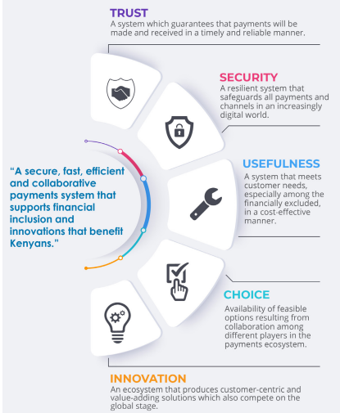
National Payments Strategy 2022-2025
2.
Vision
A secure, fast, efficient and collaborative payments system that supports financial inclusion and innovations that benefit Kenyans
Principles
Trust
Security
Usefulness
Choice
Innovation

Slide 4














3.
Kenya Payments’ Ecosystem Landscape
Main Players in the Ecosystem
Financial institutions.
Payment Service Providers (PSPs)
FinTechs.
Government.
Regulators and Government
Emerging Technologies
Infra Providers
The Pillars of the Ecosystem:
Banks, PSPs and Financial Institutions
Payment Ecosystem
Tech Providers
A Vibrant Fintech Community.
Active Established Players.
Access to Risk Capital.
Political Support.
Innovative Regulators.
Access to Talent.
Collaboration.
Conducive Business Environment.
Startups
Investors and Incubators
Consumers and Tech Users
|

Slide 5
4.
Collaboration with other Regulators
Others
Capital Markets Authority
Office of the Data Commissioner
Kenya Revenue Authority
Sacco Societies Regulatory Authority
Insurance Regulatory Authority
CBK
Competition Authority of Kenya (CAK)
Communications Authority (CA)
Financial Reporting Centre (FRC)

Slide 6
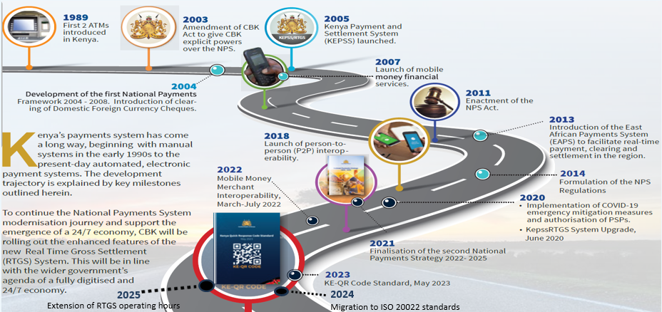
5.
Kenya National Payments System Evolution

Slide 7
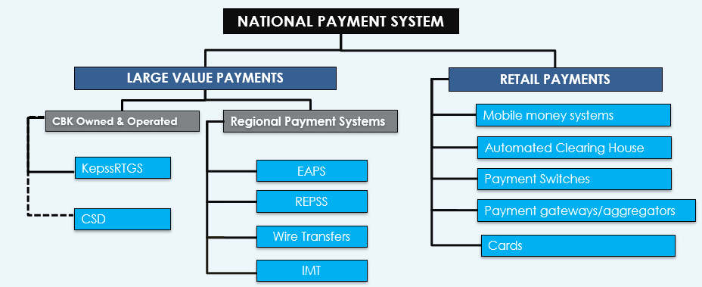
6.
Structure of the National Payments System
Central Securities Depository (CSD)
EAPS - East African Payment System for the EAC
REPSS - Regional Electronic Payment Settlement System for COMESA
IMT - International Money Transfer.

Slide 8
The Regulatory Landscape of National Payment System (NPS)
7.
Policy and data Analysis
National Payment System
Licensing and Authorization
Payment Systems Operation
Supervision – Oversight and Compliance

Slide 9
Categories of Payment Service Providers (PSPs)
8.
License Type | License Category
1. Payment Service Provider | Payment Initiation Service Provider Account Information Service Provider Merchant Acquiring Electronic Wallet Provider Virtual Asset Wallet Provider Money Remittance Service Provider Electronic Money Issuer Stable Coin Issuer Banks and Micro - Finance banks *
2.Payment System Operator | Payment Gateway Virtual Asset Payment Gateway Processor Electronic Payment Messaging Service Provider Card Scheme Provider Payment Switching Services
3.Payment Systems operated by Central Bank | Real Time Gross Settlement Systems Cross -Border Payment Settlement Systems Automated Clearing House Central Securities Depository for Government Debt Securities
4.Any other Payment System operated by the Central Bank

Slide 10
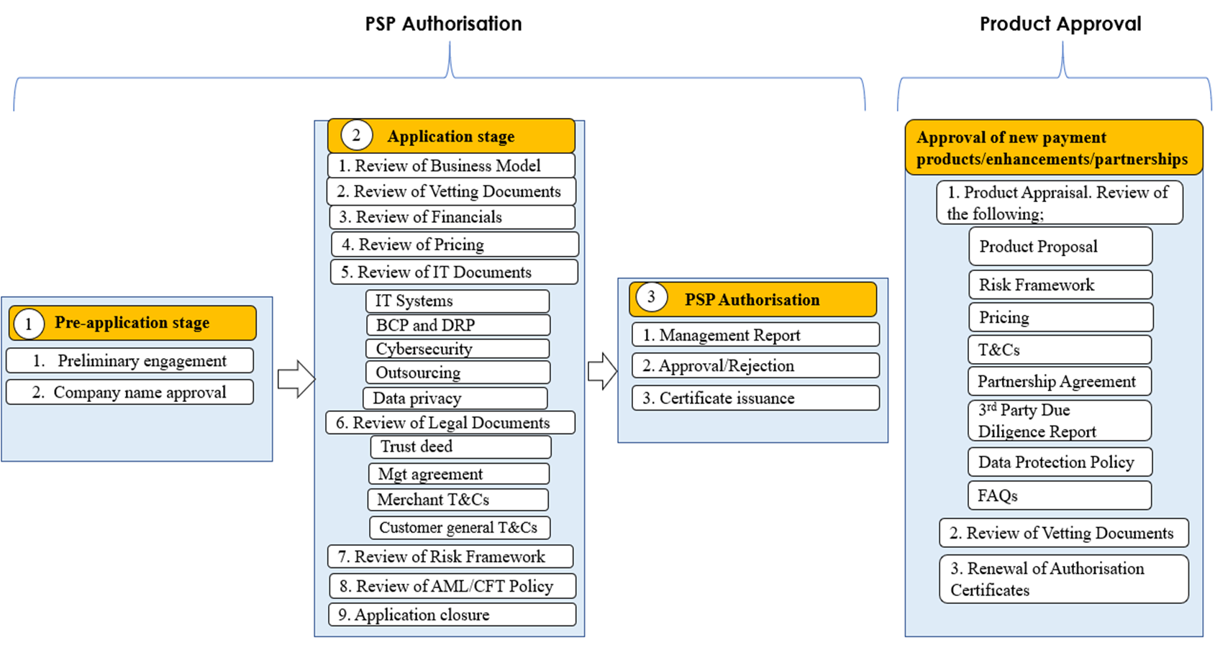
PSP Licensing Procedure
9.
Challenges of PSP Licensing
Incomplete applications slowing down the authorisation process
Manual processing of PSP applications
Reliance on third party agencies for EDD of applicants causes delays in the review process.
Legal framework limitations e.g., definition and classification of payment service providers versus technology platform providers.
Resource constraints, the team is limited in size leading to backlogs and longer approval times for applicants.
Proliferation of PSPs providing similar services. How many is enough?
The whole authorization procedure takes 180 days subject to various reasons like documents completeness

Slide 11

10.
As of Dec 2024
Source: CBK
Notes:
Bank Institutions include:
Commercial banks-38
MFBs-14
Non-bank institutions include:
E-money issuer-8
E-Wallet -8
Payment Gateway-21
Switches-3
MRPs-29

Slide 12





11.
PSPs Oversight and Compliance Process
7.
Risk-based annual compliance reviews, i.e., governance, internal controls, risk management and customer relationship.
Ad-hoc onsite supervision.
Compliance with Laws and Regulations e.g., POCAMLA, NPS.
Assess PSPs frameworks on governance, risk management, and internal controls.
Safeguarding of Customer Funds
Monitoring returns via EDW dashboards
Regulatory Expectation through circulars, guidelines, etc.
Knowledge Sharing via training, correspondence, etc.
2.
Onsite Examination
4.
Communication
3.
Supervisory Actions
1.
Continuous off-site monitoring
Recommend / Order
Warning
Fine
Suspension
Revoke license

Slide 13
12.
PSPs Oversight and Compliance Scope and Challenges
7.
Scope
Assessment of FMIs - KEPSS, CSD,PSOs
Cybersecurity and AML/CTF/CPF
Oversight of Retail payment – E-money, E-Wallet, Gateways and Switches.
Market conduct i.e., Consumer issues and Product offerings
Challenges
Weak governance and internal controls
Financial solvency, i.e. capital, gearing and liquidity of PSPs
Non-standardised reporting, i.e. IT security, Financials, etc.
Weak financial crime compliance (Fraud, AML, CFT, etc
Fragile IT systems and cyber resilience gaps.
Weak consumer protection redress mechanism.
Inherent deposit protection concerns of customer funds.

Slide 14
Payment System Operations (PSO)
13.
a.) National Level
b.) Regional Level
c.) International Level
RTGS- KEPSS
USD
Etc.
KES
East African Payment Systems
EAPS
Regional Payment and Settlement System
Kenya
Uganda
Tanzania
Rwanda
SWIFT RAILS
Facilitates international payments
Multi-currency
DRC
Egypt
Kenya
Malawi Mauritius Rwanda Eswatini Uganda
Zambia
ACH
EFT
CHEQUES
DFCC
REPSS
Connecting Kenyan Banks Globally

Slide 15






14.
Kenya Payment Ecosystem – Snapshot of Statistical Highlights
30 – Days Active Mobile Money Accounts
36.9 Million
30 – Days Active Mobile Money Customers
29.7 Million
Population Size
52.43 Million
Number of Active Mobile Merchants
710,823
30-day Mobile penetration rate
56.6%
Number of Bank ATMs
2,289
Number of Active Mobile Money Agents
381,116
First Quarter Real GDP growth rate 2025
4.9%
Number of POS
48,653

Slide 16
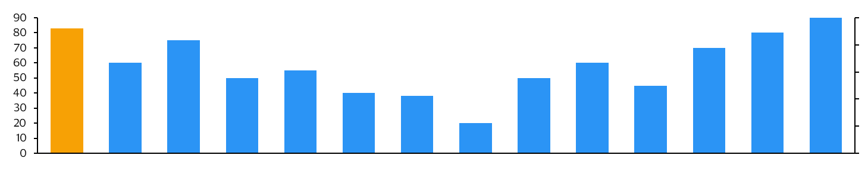
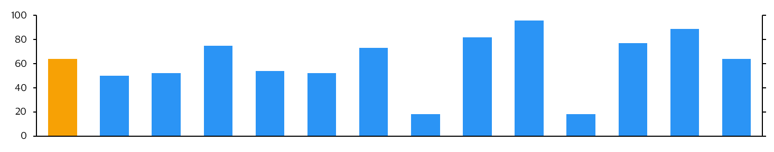
Kenya demonstrates strong adoption and penetration in digital payments, positioning it well for further expansion, yet still has significant potential to reach global benchmarks
15.
Adoption and Penetration
Digital Payment Use base (% of Population)- Number of users utilizing digital payment platforms.
Kenya demonstrates a robust digital payments user penetration rate of approximately 64%, surpassing India (18%), Nigeria (18%), Uganda (50%), and Tanzania (52%). In comparison, leading nations such as Sweden and Singapore exhibit penetration rates of 96% and 89%, respectively.
In terms of mobile wallet penetration, Kenya leads all the comparators at 83% except China at 90%
East Africa Comparators
Africa Comparators
96%
Global Comparators
73%
82%
89%
75%
77%
64%
64%
50%
52%
54%
52%
18%
18%
Kenya
Uganda
Tanzania
Rwanda
Morrocco
Ivory Coast
Ghana
Nigeria
South Africa
Sweden
India
South Korea
Singapore
China
Mobile Wallet Penetration (% of Population)- Percentage of the population using mobile wallets.
East Africa Comparators
Africa Comparators
Global Comparators
90%
83%
75%
80%
70%
60%
55%
60%
50%
50%
45%
40%
38%
20%
Kenya
Uganda
Tanzania
Rwanda
Morrocco
Ivory Coast
Ghana
Nigeria
South Africa
Sweden
India
South Korea
Singapore
China
Total Population
55M | 50M | 67M | 13M | 37M | 29M | 34M | 224M | 61M | 10M | 1.4B | 52M | 5.6M | 1.4B
Sources: Central Banks: Central Bank of Kenya (CBK), Sveriges Riksbank (Swedish Central Bank), Reserve Bank of India (RBI), Bank of Korea, Monetary Authority of Singapore (MAS), People’s Bank of China, South African Reserve Bank (SARB), Central Bank of Nigeria (CBN), Bank of Ghana, Bank Al-Maghrib (Morocco), Central Bank of West African States (BCEAO) for Ivory Coast.
Communications Authorities: Communications Authority of Kenya (CAK), Nigerian Communications Commission (NCC),
Market Research Firms: Statista, McKinsey, BCG.
Mobile Money Providers: Safaricom (Kenya), MTN, Airtel, Orange.
Source: Visa

Slide 17

Year on Year % Growth on the number of transactions
16.
Growth between 2020 vs 2024
11%
Growth between 2020 vs 2024
187%
Growth between 2020 vs 2024
45%
Source: CBK

Slide 18































Understanding the stages of payment ecosystem development and challenges of every step of transition can guide the actions to take to support growth
17.
Stages of Payment Ecosystem Development
Current stage
NON-EXHAUSTIVE
Key takeaways
High
Transition
Electronic
Electronic Markets: Focus on advancing niche payment methods like mobile wallets and wearables, as cashless payments are already standard
Cash-Centric Economies: Require infrastructure upgrades and trust-building measures, like fraud prevention, to boost adoption
Transitioning Markets: Governments and businesses use incentives to drive electronic payment adoption
Resistant Markets: Campaigns highlighting convenience and security, especially for tourism, can encourage adoption
Progression along Acceptance Development Lifecycle
Electronic payments not yet used for everyday spend
Electronic payments are “top of wallet” Specific niches payments remain
Consumer adoption
UAE, Saudi Arabia, South Africa, Taiwan, Malaysia, Uruguay, Russia, Venezuela, Poland, Kenya
Australia, South Korea, United Kingdom, Sweden, France, Canada, United States
Cash-centric
Resisting Transition
Heavily dependent upon cash payments
Early stages of electronic payments ecosystem
Consumers resistant to electronic payments
Need to demonstrate utility of electronic payments
Low
Azerbaijan, Egypt, Myanmar, India, Vietnam, Indonesia, Romania, Ukraine, Guatemala, Morocco
Japan, Greece, Spain, Italy
Acceptance Promotion
Low
High
Source: VCA Analysis, Financial Payments Acceptance Incentives report

Slide 19
18.
Performance of Kenya National Payment System
 | Volume, Bn | Value, Kes. Tn
Mobile | 25.41 | 33.07
Cards | 0.12 | 0.85
EFTs | 0.02 | 1.01
Cheques | 0.01 | 2.48
KEPSS | 0.01 | 45.35
In Kenya, mobile payments dominate with 99% of all transactions but only 40% of the total value, indicating they are mostly small amounts.
KEPSS handles over half (55%) of the transaction value but very few transactions, showing it is used for large payments. Cards, EFTs, and cheques have minimal usage.

Slide 20
19..
Driving Financial Inclusion: Mobile’s Impact from 2006 to 2024
Financial inclusion has grown dramatically from 26.7% in 2006 to 84.8% in 2024.Mobile financial services are the major growth driver, rising from 0% to over 82%.Mobile money’s rise reflects technology adoption and its impact on increasing access to financial services.

Slide 21


20.
Evolution: Mobile Money has played a Transformative Role in Financial Services
Access
Access
Focus on unbanked
1Mn Customers Transacting in a day
High penetration
18Mn Customers Transacting in a day
FUTURE
Services
Services
Loans, payments, APIs
Access
Key players
P2P transfers
Universal
inclusion
>25Mn Customers Transacting in a
day
FUTURE
PAST
PRESENT
Neobanks, AI-driven apps
Key players
Key players
M-Pesa, Airtel Money
Full banking, investments, insurance
Consumer-centric, interoperable
M-Pesa, KCB, Equity, FinTech's
Regulation
Regulation
Regulation
Services
Flexible/
experimental
Structured Daily Cumulative Position rules
Source : CBK

Slide 22
21.
Proportion of men and women at each stage of mobile money user journey in 2024, by country
Countries | Gender | Mobile ownership | Mobile money awareness | Mobile money account ownership | Used mobile money in the last 90 days | Used mobile money in the last 30 days
Egypt | Male | 89% | 68% | 15% | 15% | 14%
 | Female | 86% | 62% | 6% | 6% | 5%
Ethiopia | Male | 86% | 74% | 22% | 19% | 17%
 | Female | 65% | 57% | 9% | 6% | 5%
Kenya | Male | 95% | 99% | 95% | 95% | 93%
 | Female | 93% | 99% | 94% | 93% | 89%
Nigeria | Male | 94% | 88% | 43% | 41% | 39%
 | Female | 91% | 80% | 25% | 22% | 20%
Senegal | Male | 92% | 100% | 91% | 88% | 85%
 | Female | 81% | 97% | 74% | 71% | 65%
Tanzania | Male | 93% | 99% | 97% | 93% | 86%
 | Female | 91% | 99% | 96% | 92% | 82%
Uganda | Male | 90% | 97% | 88% | 83% | 78%
 | Female | 85% | 96% | 80% | 73% | 65%
Bangladesh | Male | 85% | 82% | 52% | 50% | 46%
 | Female | 68% | 67% | 23% | 20% | 18%
India | Male | 84% | 43% | 16% | 13% | 13%
 | Female | 71% | 31% | 7% | 5% | 5%
Indonesia | Male | 91% | 54% | 21% | 18% | 16%
 | Female | 87% | 50% | 23% | 18% | 16%
Pakistan | Male | 93% | 86% | 32% | 29% | 24%
 | Female | 58% | 81% | 9% | 7% | 6%
Philippines | Male | 72% | 84% | 35% | 32% | 29%
 | Female | 73% | 90% | 41% | 38% | 35%
Overall, Kenya has the highest percentage of mobile money accounts actively used by both genders in the past 30 and 90 days, highlighting strong adoption of mobile money services
Source : 2024 GSMA Consumer Survey

Slide 23
How Money Enters the Mobile Money Ecosystem
22.
(a) Through Mobile Agents Cash in (deposits) and Cash out (withdrawals)
The gap between cash-in and cash-out transactions continues to widen, indicating that more funds are remaining within the mobile money ecosystem rather than being withdrawn as physical cash
Mobile agents in Kenya play a critical role in promoting financial inclusion by providing cash-in and cash-out services, especially in remote and underserved areas. With 381,116 active agents across the country, they bridge the gap between digital money and cash. The continued increase in cash-in volumes means more money stays within the mobile money ecosystem, allowing users to perform a variety of transactions, such as paying merchants and sending money to other individuals.
Source : CBK

Slide 24
23.
(b) Through Bank account to E-Wallet (Money in) and E wallet to bank (Money out)
Over the years transfer of money Bank account to mobile money E-Wallet has continued to increase. The increase is driven by the convenience, speed, and accessibility of mobile money. As more people adopt digital financial services, they prefer transferring funds to mobile wallets for everyday transactions like paying bills, shopping, or sending money. Additionally, improved integration between banks and mobile platforms has made these transfers faster and easier.
Source : CBK

Slide 25
Other Retail Payments - (a) EFT and Cheques Transactions
24.
In the era of Instant Payments is EFT still relevant, should IP be mandated?
Who Issues Cheques?
What is the future of cheques?
EFT (Electronic Funds Transfer)
Widely used for business-to-business and salary payments. EFT is preferred for large-value, less frequent transactions due to its security and traceability, making it significant in formal banking but less so for daily consumer spending.
Cheques
Usage has declined significantly, as electronic payment methods gain prominence. Cheques are mostly used in corporate and government transactions but are increasingly being replaced by EFT and mobile payments.
Source : CBK

Slide 26
(b) Card Transactions
25.
7.
Cards acceptance remains low
Challenges
Settlement time current T+1
Merchant Discount Rate (MDR) that is non-competitive between 1.5% to 3%
Cost to merchant discouraging them to use cards
Source : CBK

Slide 27
Large Value Payment System (LVPS) – KEPSS Transactions
26.
System Availability
Percentage of uptime for Q3 of FY 2024/2025 is 100%, no downtime reported.
RTGS KEPSS Operating hours revised with effect from July 1, 2025, to 7-7 i.e., 12 hours per day
Operational Resilience
BCP and DRS up and running. Tests scheduled for Q1 of FY 2025/2026
Planned contingency arrangements (VPN) project to commence Q2 of FY 2025/2026
Average value per transaction
Kes = 5,111,111.11
Source : CBK

Slide 28

27.
EAPS TRANSACTIONS
INWARD EAPS TRANSACTIONS VALUE IN MILLIONS
OUTWARD EAPS TRANSACTIONS VALUE IN MILLIONS
From 2020 to 2024, Kenya experienced increasing inward payments from Rwanda, Tanzania, and Uganda, reflecting stronger economic integration within the EAC. Although local currency transactions remain smaller in volume, their growth signals a shift toward greater use of regional currencies. This data highlights Kenya’s key role in advancing the EAC’s unified payments system and underscores the positive impact of digital payment innovations on cross-border trade and finance
From 2020 to 2024, Kenya’s outward transactions steadily increased across East African countries Rwanda (RWF) and Uganda (UGX) rose steadily. However, in 2023, Uganda experienced a rapid decline, possibly indicating shifting trends in the adoption of local currencies for cross-border payments. Tanzania (TZS) saw a sharp increase in transactions in 2022, followed by a decline in 2024, likely linked to infrastructure changes and market normalization
Source : CBK

Slide 29
Efforts towards Cash Displacement
28.
Currency in circulation %, 2011 to 2024
Source Central Bank of Kenya, 2024 Nominal GDP is a CBK Projection, KNBS will release official statistics later in April 2025

Slide 30
29.
(a) Measure of the extent of how, Kenyan economy is digitized
Currency outside banks 1.8%
Source: IMF statistics.
Source: IMF statistics.

Slide 31
30.
(b) Measure of the extent of how, Kenyan economy is digitized
EAST AFRICA
GLOBALLY
Kenya's currency in circulation is low and stable at about 3% of GDP, indicating strong digital transformation. Compared to East African Community (EAC) countries e.g., Uganda and Tanzania Kenya's decline reflects reduced dependence on cash, largely due to widespread use of mobile money (e.g., M-Pesa).
Kenya is notable globally for its highly digitized monetary system, despite being an emerging market. Compared to China, India, and the U.S., which still have higher currency-to-GDP ratios due to size and cultural factors, Kenya’s shift is uniquely mobile-driven and grassroots.
Source: IMF statistics.
Source: IMF statistics.

Slide 32
Government Payments and Remittances
31.
U.S.$4.95 Bn
Ksh.2.50 Tn
Gov’t Payments to commercial banks, 2024
(Source: Central Bank of Kenya)
Diaspora receipts, 2024
(Source: Central Bank of Kenya)

Slide 33

Remittance inflows have remained resilient, growing by 18% in 2024
32.
Global average cost of sending $200 was 6.39% in Dec 2023 from 9.1% in 2013. These current costs are still more than twice the SDG 10.c target of 3%
Africa remains the most expensive region in the world for sending remittances. The continental average for remittance costs is 7.9%.
Source: World Bank, GSMA
Source: CBK Database

Slide 34
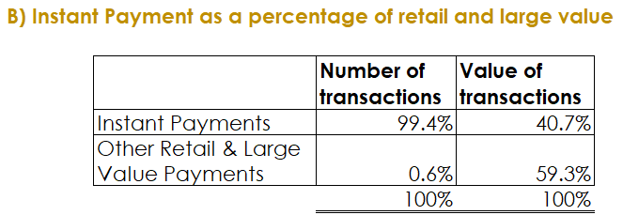
33.
Instant Payment Performance 2024
Instant Payments used for the case above is Mobile payments and P2P Switch
Retail Payments include; Mobile, cards, EFT, Cheques and P2P switch.
Large value include RTGS transactions
Instant payments in Kenya, driven by mobile money now power over 99% of transactions. Traditional methods like EFT, RTGS, and cheques remain slow and need upgrading to real-time. Modernizing all payment rails is key to a fully digital, cash-lite economy. The future of payments is instant, Interoperable, inclusive, and always on.
Source: CBK

Slide 35
34
Policy context and objectives /5 Current usage
Current Usage, 2024
 | Volume, Mn | Value, Ksh. Bn | Funds received
Cheques | 14 | 2,540 | T+1
EFT | 17 | 947 | T+1
Offnet Transactions(Mobile money) | 1134 | 7,862 | Instant
Pesalink | 6 | 927 | Instant
Source: CBK Data returns Cheques and Electronic Funds Transfer (EFT) transactions are not inherently instantaneous, presenting an opportunity to enhance their speed and immediacy. Pesalink an instant payment platform has not been able to scale up/fully optimised

Slide 36
35.
Challenges in Enhancing Payment System Interoperability
Lack of Shared Infrastructure
The absence of unified infrastructure results in fragmented and underutilized ATMs and POS devices, driving up operational costs. Establishing shared ATM/POS networks would lower costs and expand accessibility, particularly in underserved areas.
Lack of Open Multilateral Platforms
Reliance on bilateral agreements increases operational complexity and costs, restricting scalability for smaller players. Promoting open collaboration among telcos, banks, and non-banks can improve efficiency and broaden market reach.
Technical Incompatibility
Banks, telcos, and fintechs use different systems, APIs, and security protocols, making integrations costly, time-consuming, and prone to errors. Legacy infrastructure and mismatched processing methods further hinder seamless interoperability.

Slide 37
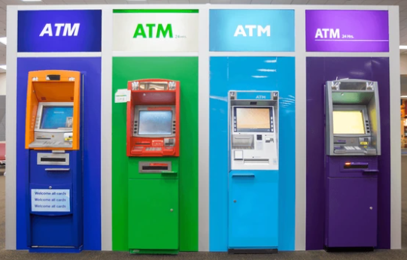

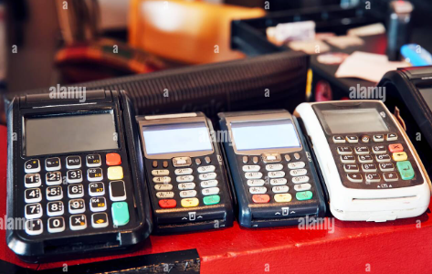
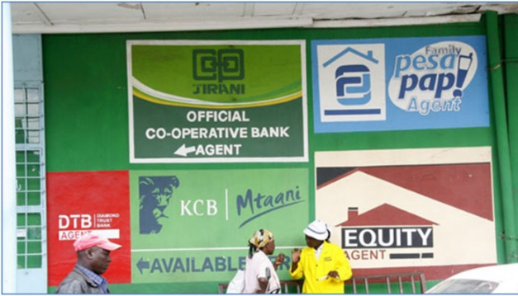
36
Challenges in Enhancing Payment System Interoperability
Limited infrastructure sharing
Inefficient utilization of physical infrastructure (ATMs and POS devices)
Multiple/closed systems telco, banks, non-banks
Multiple banks ATMs
Outlet recruited by different players
Cashier counter displaying several POS
Lack of sharing infrastructure by agents

Slide 38




37
Challenges in Enhancing Payment System Interoperability
Limited functional interoperability
Bilateral agreements with costly bilateral connections.
Each bilateral arrangement requires a separate agreement, connectivity, prefunding
Bank/Wallet transfers
Bank/Wallet transfers
Bank/Wallet transfers
Bank/Wallet transfers
P2P
Merchant Interop

Slide 39
38.
Practical illustration - Challenges in Current Payments Models
High cost of low-value retail payments
Inefficiency, constrained oversight, stability challenges
Cumbersome customer experience, friction in off-net payment transactions
Exclusion – institutions that must participate in NPS through PSPs or banks
Key Takeaways
High transaction costs, digital payments cost about 2% of a salary, which remains high, especially for low-income users.
Cash preferred for cost savings, users often cash out via mobile agents or ATMs, as cash transactions are generally cheaper than digital ones.
Need to review charges, Reducing digital transaction fees could encourage more people to adopt cash-lite behavior and support Kenya’s move toward a more inclusive digital payments ecosystem.

Slide 40
Analysis of Social Engineering Frauds 2025
The graph shows social engineering frauds where fraudsters manipulate individual often through calls, SMS, or messaging apps into voluntarily sharing confidential information such as mobile money PINs, ID numbers, bank details to making unauthorized transactions.
These frauds exploit trust, urgency, or fear, rather than hacking systems, to trick victims.
Over the last eight months in 2025 reported 199,484 fraud incidents valued 819.8 Million

Slide 41
39
Why an FPS for Kenya- The Future
Vision
Kenyans seamlessly paying and being paid by Anyone, Anywhere, Anytime
Benefits
Open &
Interoperable systems
Financial Sovereignty
Transparency & formalization
Cross-border Linkages
Open Banking and Finance
Open shared infrastructure with multilateral agreements moving from closed loop systems with bilateral agreements.
Autonomy from international schemes. Having the ability to process all domestic transactions domestically.
Enhanced visibility of payments and improved efficiency in government collection.
Point to point linkage to regional and cross border systems resulting in increased remittances.
Promote an ecosystem of collaboration, driving better financial products, greater efficiency, and more inclusivity.
Outcome
A robust, inclusive, resilient and globally competitive economy
Financial Inclusion and Health (Usage, Impact, Access)
Cash Displacement
Vibrant Fintech Ecosystem
Convenient and affordable digital payments
Multiplier of economic activity

Slide 42
40.
Key Lessons Learnt
Customer centricity – CBK’s vision is for a payments system that is secure, efficient and widely available to and works for Kenyans.
The usefulness of technology does not lie in its uniqueness, but in its ability to solve a pressing societal problem.
Country context – one size does not fit all.
Consumer protection in the face of innovations must be a key focus.
Regulators should clearly understand new innovations and risks therein - ‘‘Test and learn’ ’or “walking alongside innovators” approach..
Collaboration with other central banks and regulators.
Leveraging data to identify customer needs
It is not about institutions but ecosystems
Activity based supervision, focus on risks from activities – Proportionate supervision of similar activities.

Slide 43

Policy Initiatives to Enhance Payment Services
41.
Review of the NPS Law and Regulatory framework to align it with the current developments and emerging realities in the payments sector, domestically and globally.
Implementation of Interoperable Fast Payment System: CBK is currently coordinating the implementation of an industry-wide interoperability through the implementation of national fast payment system (national switch) for all retail payments in Kenya.
Review of KEPSS Operational Framework Extension of KEPSS operating hours to 7am –to- 7pm(implemented) and progressing towards 24/7 and onboarding of Non-bank FSPs.
Implementation of VPN De-risking of the national payment system large value payment system (RTGS) through implementation of a Virtual Private Network.

Slide 44
Policy Initiatives to Enhance Payment Services
43.
Conduct enhanced and more frequent on-site inspections on institutions, including improving the risk-based AML framework.
Development a consumer protection framework ongoing to safeguard the consumers against exploitations and to fast-track consumer complaint handling.
Conduct targeted industry engagements/capacity building programs on cyber-security, AML/CFT/CPF, data protection and governance as focus areas.
Implementation of Granular Data Integration (GDI) project to collect granular data to support policy and oversight of payment systems.
The EAC Masterplan is a five-year strategic framework with 20 initiatives implemented in short (1-2 years), medium (3-5 years), and long-term (beyond 5 years) phases. It is built on four pillars: Governance & regulatory framework, Infrastructure, Inclusivity, and Capacity building. Success will be measured by faster transactions, lower costs, greater accessibility, and improved transparency in EAC cross-border payments.

Slide 45
Policy Initiatives to Enhance Payments Services
44.
Finalizing a framework to regulate and supervise Virtual Assets and Virtual Asset service Providers (VASP)
Enhance existing MOUs with existing and new regulators e.g. The Office of the Data Protection Commissioner, Financial Reporting Centre (FRC), Communications Authority (CA), Capital Markets Authority (CMA), Insurance Regulatory Authority (IRA), SASRA, etc. to devise a common approach in supervision of AML/CFT/CPF.
Development of Cross-border payments tracking framework to align with the Financial Stability Board (FSB) /G20 Roadmap for Enhancing Cross-border Payments to aid in overcoming the challenges of High Cost, Low Speed, Limited Access, Insufficient Transparency
The East African Payment System (EAPS) for the East African Community. Settlement is in local currencies (KES, UGZ, TZS and RWF).Upgrading EAPS to EAPS2 (Single shared platform and EAPS Regional Publicity to increase awareness and hence uptake

Slide 46

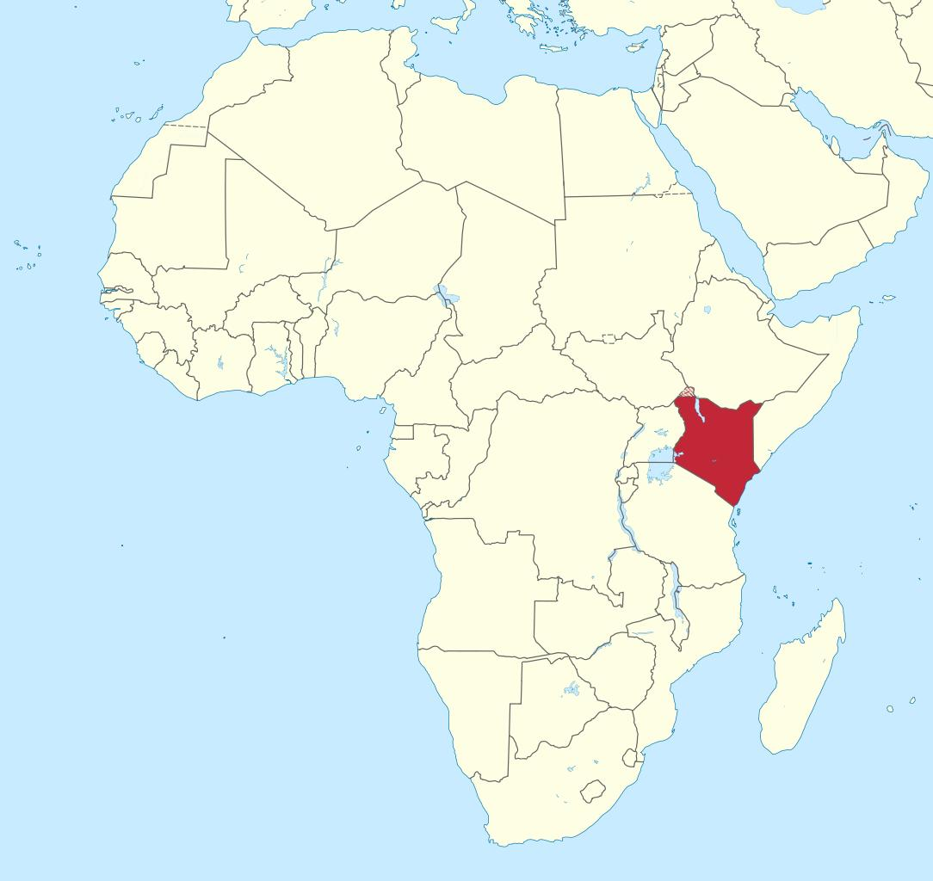

ASANTE (THANK YOU)
All rights to the pictures acknowledged
The famous wildebeest migration – crossing the crocodile infested Masai Mara river

Slide 47


